Slide 1
TEXT GENERATION USING LSTM AND IBM WATSON STUDIO
TEAM MEMBERS:
NAVANEETHAN P
PRAVEEN KUMAR NK
VISHAL PMB

Slide 2
INTRODUCTION
In text generation, we try to predict the next character or word of the sequence. The text data generally considered as sequence of data. For predicting data in sequence we used deep learning models like RNN or LSTM. LSTM are preferred over RNN in this because of RNN vanishing and exploding gradients problem. In text generation we have to memorize large amount of previous data. So for this purpose LSTM are preferred.

Slide 3
PROBLEM STATEMENT
One way of looking at this vanishing gradient problem is that the network is trying to propagate all the information through longer sequences. And with longer sequences, the gradients are getting diminished during BPTT. To remedy this issue, Long short term memory network (LSTM) [is introduced.

Slide 4
SOLUTION
The phrases in text are nothing but sequence of words. So, LSTM can be used to predict the next word. The neural network take sequence of words as input and output will be a matrix of probability for each word from dictionary to be next of given sequence. The model will also learn how much similarity is between each words or characters and will calculate the probability of each, Using that we will predict or generate next word or character of sequence.

Slide 5
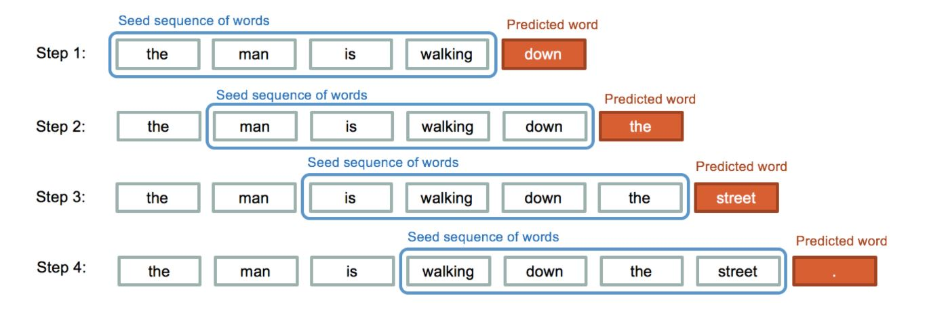

Slide 6
EXPERIMENTAL INVESTIGATIONS:
At the beginning of the project we took nearly 60+ lakh characters as dataset which nearly estimated 160 hrs of training the dataset
Later due to long period we changed our dataset which had 2+ lakh character only took 150 min to train.
We did not have better graphics card to handle to use the other dataset
It generally conforms to the line format observed in the original text of less than 80 characters before a new line.
The characters are separated into word-like groups and most groups are actual English words (e.g. “the”, “little” and “was”), but many do not (e.g. “lott”, “tiie” and “taede”).

Slide 7
HARDWARE, SOFTWARE SPECIFICATION:
Minimum supported hardware
Processor - Intel® x86 1 GHz or equivalent processor
Memory (RAM) - 3 GB (default install)
Network - TCP/IP
GPU - Nvidia Geforce cards
Software requirements
Tensor flow 2.5 version
Anaconda Navigator
Spider
IBM Watson studio
IBM cloud

Slide 8
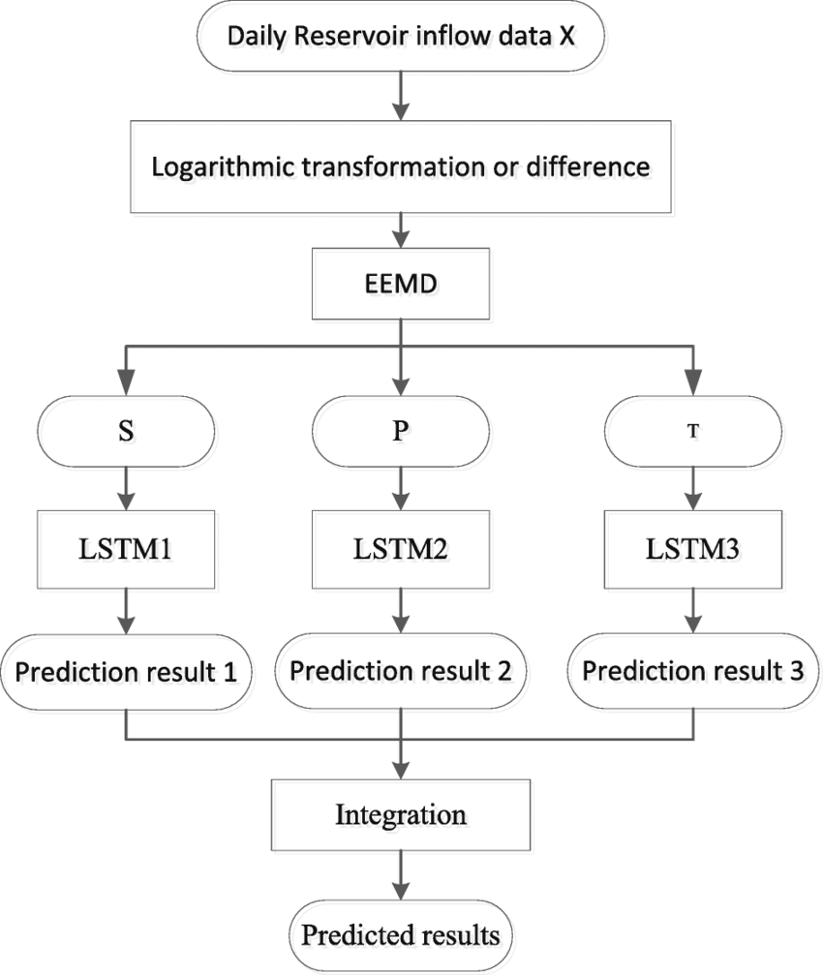
FLOWCHART:

Slide 9
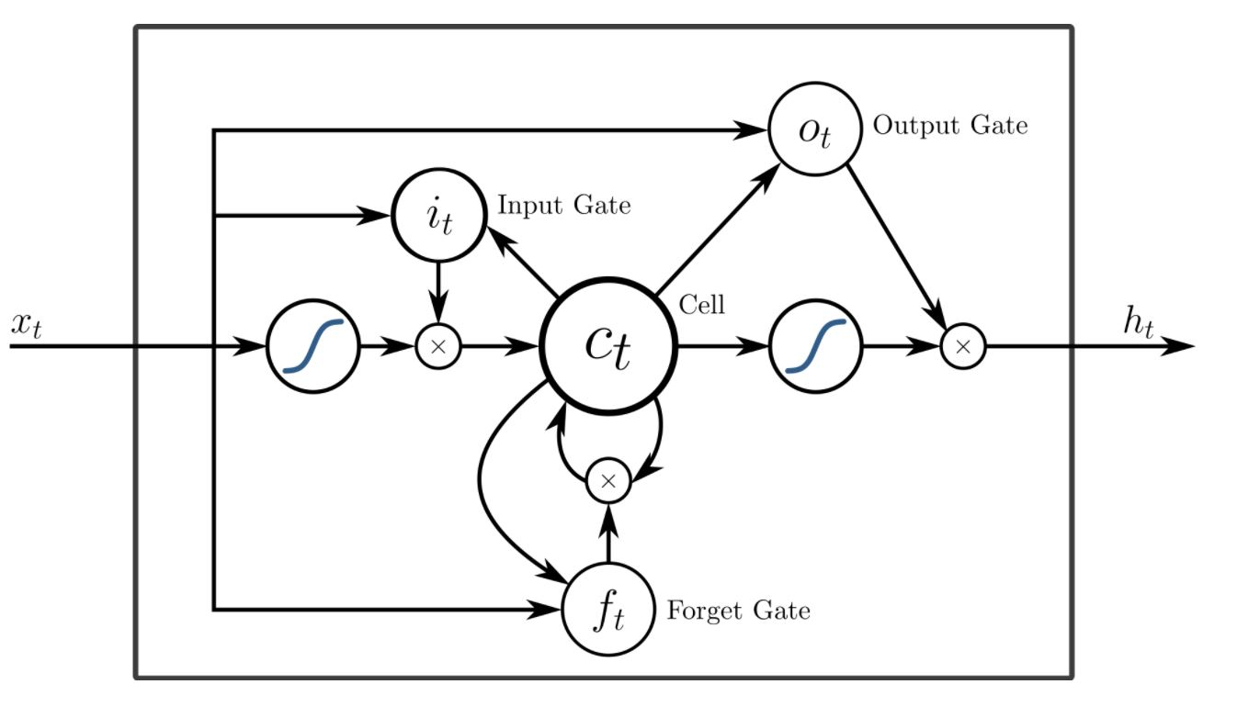

Slide 10
CONCLUSION:
Text Generation is a type of Language Modeling problem. Language Modeling is the core problem for a number of natural language processing tasks such as speech to text, conversational system, and text summarization. A trained language model learns the likelihood of occurrence of a word based on the previous sequence of words used in the text. Language models can be operated at character level, n-gram level, sentence level or even paragraph level. In this project, we are creating a language model for generating natural language text by implementing and training state-of-the-art Recurrent Neural Network.
The fact that this character based model of the book produces output like this is very impressive. It gives you a sense of the learning capabilities of LSTM networks. Your results may vary given the stochastic nature of the algorithm or evaluation procedure, or differences in numerical precision. Consider running the example a few times and compare the average outcome

Slide 11
FUTURE SCOPE:
Predict fewer than 1,000 characters as output for a given seed.
Remove all punctuation from the source text, and therefore from the models’ vocabulary.
Try a one hot encoded for the input sequences.
Train the model on padded sentences rather than random sequences of characters.
Increase the number of training epochs to 100 or many hundreds

